Slide 1
6D Pose Estimation on RGB images

Slide 2
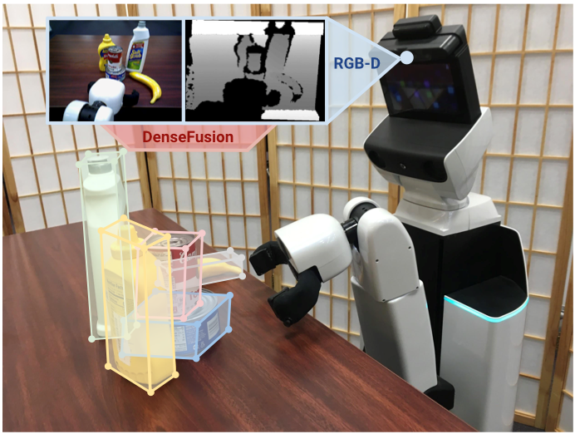
Context
retrieve objects position and orientation in an image
depth sensors may fail in some cases
extend the approach to RGB images
Image from DenseFusion: 6D Object Pose Estimation by Iterative Dense Fusion, Chen Wang & al.

Slide 3
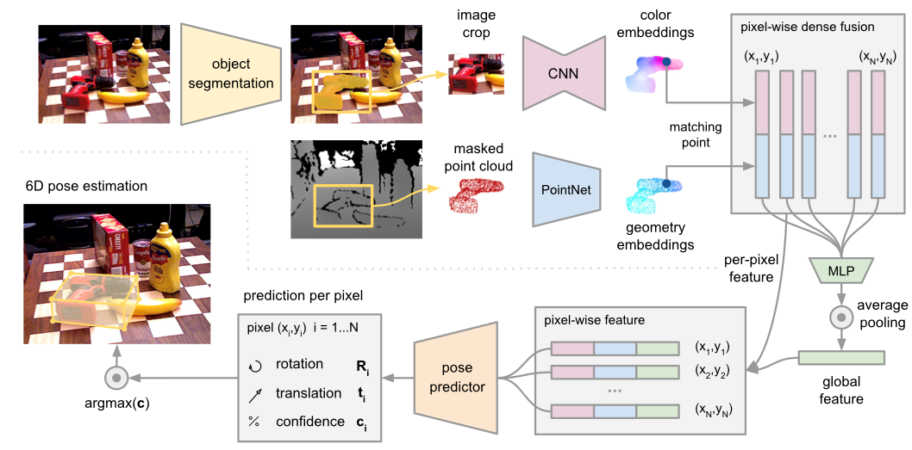
Overview of the DenseFusion method
Image from DenseFusion: 6D Object Pose Estimation by Iterative Dense Fusion, Chen Wang & al.
Notes:
recent paper, state of the art results
specificity of DenseFusion : consider geometric and color features jointly at the pixel level → also add some global features
classical approaches treated the two aspects separately
ICP refinement to improve final prediction (more classical)

Slide 4
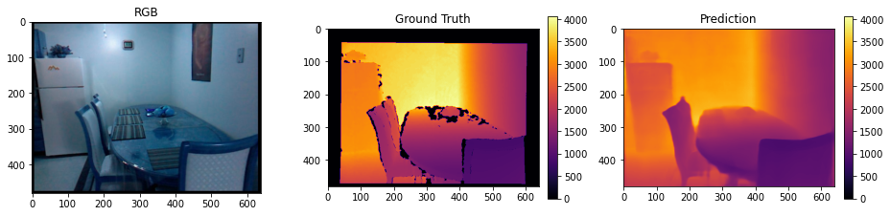
Depth prediction network : TransDepth
state of the art method on NYU Depth V2 dataset
based on transformers
available code with pretrained model
Notes:
ranked 3 on Depth NYU V2 dataset
motivate the use of transformers for depth prediction

Slide 5
Performance on Linemod dataset
use pretrained model on Linemod dataset
the performance on the masked objects only are relevant
 | RMSE
NYU Depth V2 | 0.365
Linemod | 0.842
Linemod with masks | 0.538
Notes:
should not affect the prediction since we only use the depth corresponding to the mask of the segmented object

Slide 6
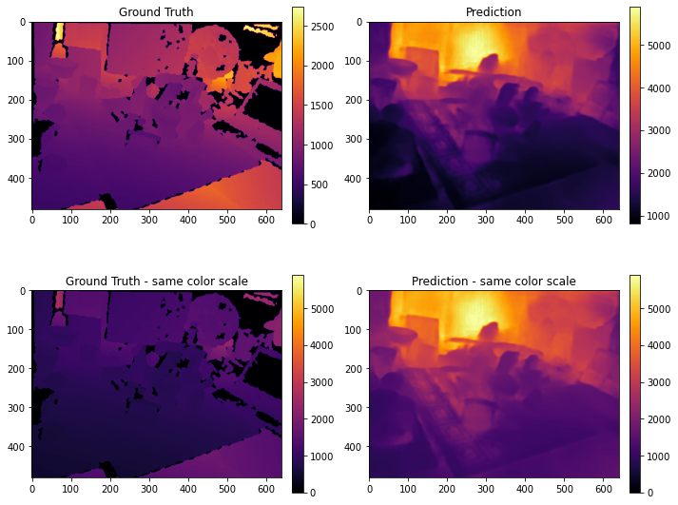
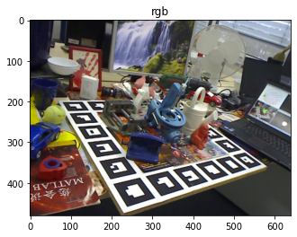
Depth prediction pitfalls
Notes:
lightning sensitive (white on the squared support and computer screen)
wrong estimation of the depth amplitude

Slide 7
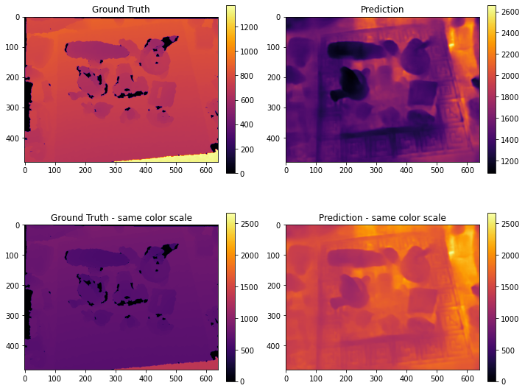
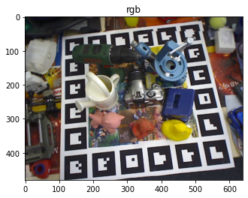
Depth prediction pitfalls
Notes:
wrong depth estimation for a fixed distance

Slide 8
Potential causes
same camera for the acquisition but different lightning conditions
datasets too different
→ plain and homogeneous areas in NYU vs many items in Linemod
→ horizontal point of views in NYU vs many different in Linemod
Notes:
- horizontal point of view in nyu vs also vertical in linemod

Slide 9
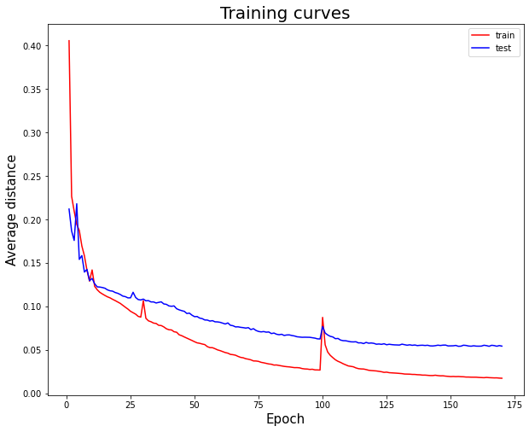
2D DenseFusion
adaptation of the code to handle RGB-only
per pixel prediction
2D geometric embedding
training for 170 epochs (about 8 days)
Notes:
motivate the conservation of the 2D geometric embedding

Slide 10
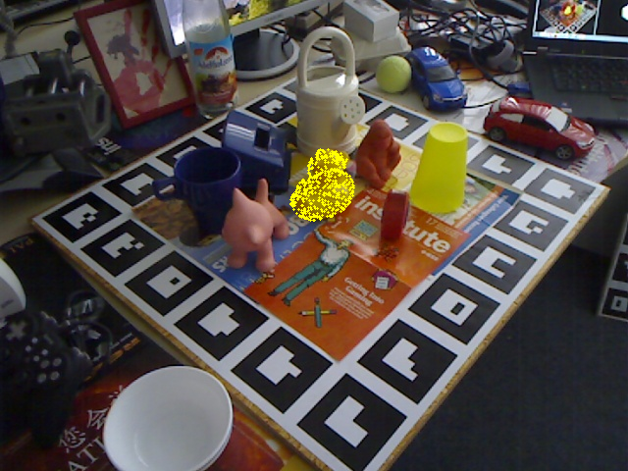
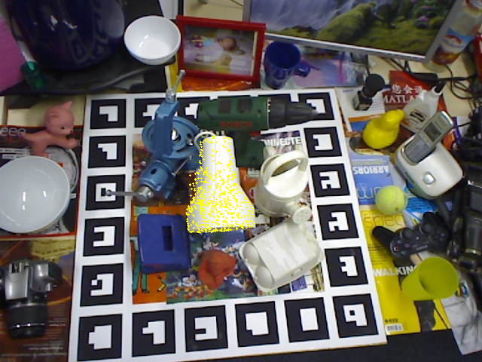
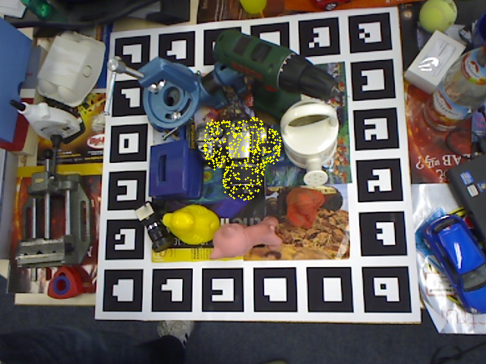
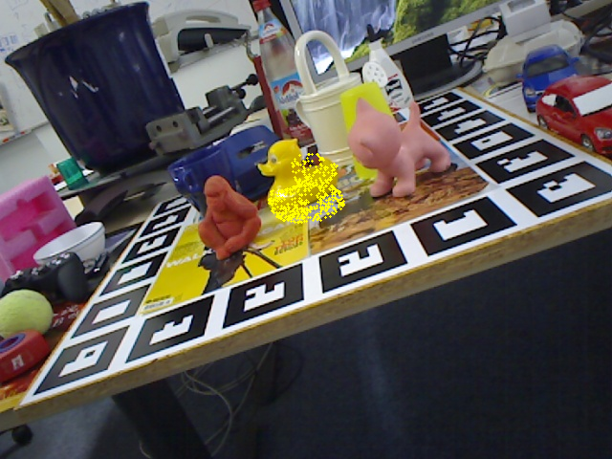
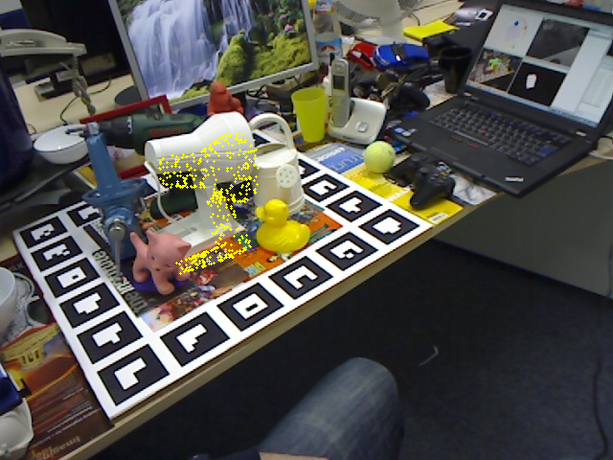
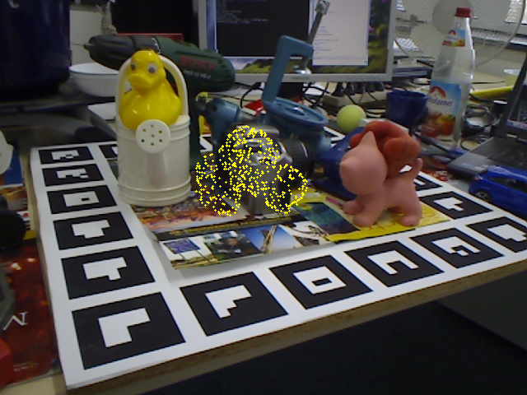
Prediction results
Notes:
- horizontal point of view in nyu vs also vertical in linemod

Slide 11
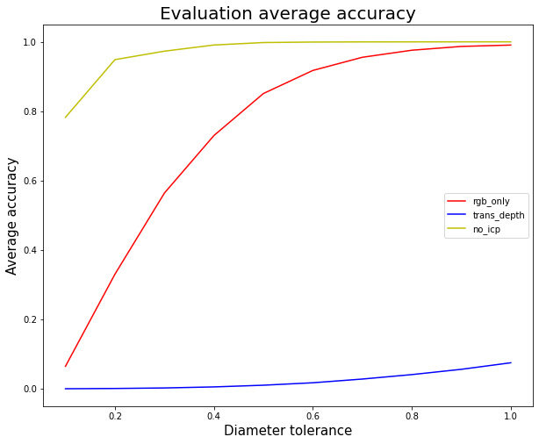
Results on pose estimation
 | Accuracy (0.1*diameter) | Average distance
DenseFusion | 94.2 % | 0.74 cm
DenseFusion no ICP | 78.3 % | 1.60 cm
DenseFusion RGB | 6.5 % | 5.68 cm
TransDepth + DenseFusion | 0.0 % | 49.4 cm

Slide 12
Numerical comparison
Object | Average distance (cm) - RGB | Average distance (cm) - RGB-D no ICP
ape | 5.1 | 0.9
bench vi. | 6.3 | 1.8
camera | 6.7 | 1.4
can | 5.6 | 1.6
cat | 5.3 | 1.1
driller | 6.8 | 2.8
duck | 3.9 | 1.1
hole p. | 6.1 | 1.5
iron | 5.8 | 1.7
lamp | 4.9 | 2.0
phone | 5.9 | 1.8

